Slide 1
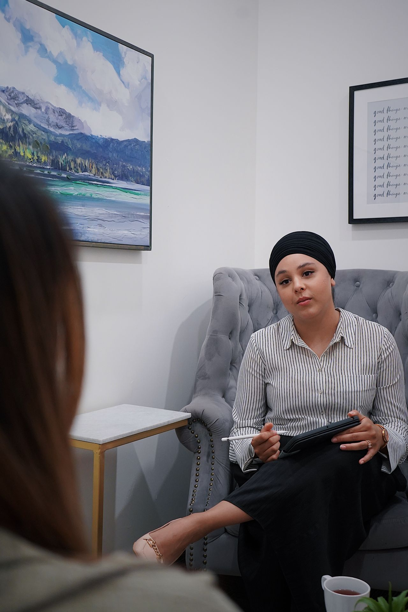
Understanding
Sadness
Grades 4–6
Together For Health

Slide 2

🌧️
Important to Know
Feeling sad sometimes is normal. Depression is different.
Depression sticks around for weeks and makes it hard to do everyday things.
Together For Health

Slide 3
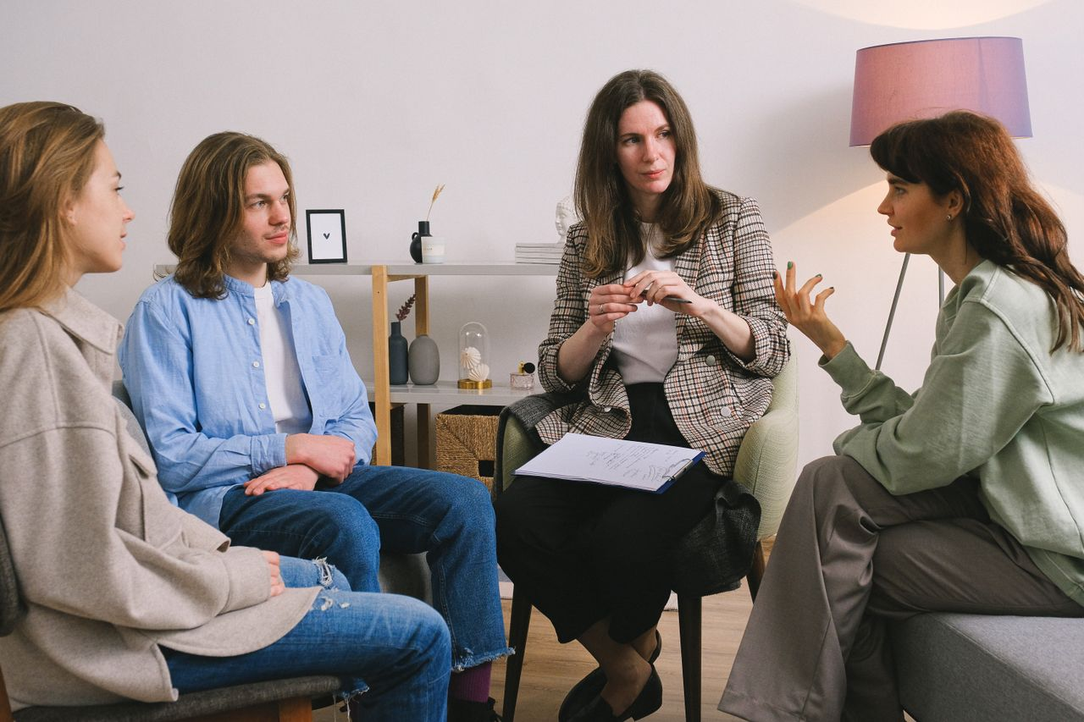
💙
What Does Depression Feel Like?
Feeling sad, empty, or hopeless most of the time
Not enjoying things you used to love
Feeling very tired even after sleeping
Hard to focus or make decisions
Body aches that do not go away
Together For Health

Slide 4
🌈
Depression Is NOT
A choice — nobody chooses to be depressed
Just being sad — it is a real medical condition
Something to push through alone
A sign of weakness
Permanent — it can get better with help
Together For Health

Slide 5
🌱
Getting Better — What Helps
Tell a trusted adult how you are feeling
1
Exercise — even a short walk helps
2
Stay connected with friends and family
3
Limit screen time and get regular sleep
4
See a doctor or counsellor — treatment works
5
Together For Health

Slide 6
KEY TAKEAWAYS
You are not alone — millions of people have depression
✓
It is a real illness, not a character flaw
✓
Getting help is the bravest and smartest thing you can do
✓
Resources
Kids Help Phone: 1-800-668-6868
Talk to a parent, teacher, or counsellor
Your family doctor can help you find treatment
Together For Health

